Slide 1
All in a day’s work
WEEK 9

Slide 2
JOBS
What Job Is Right For You ?
https://www.youtube.com/watch?v=cyXADWE7KPo

Slide 3
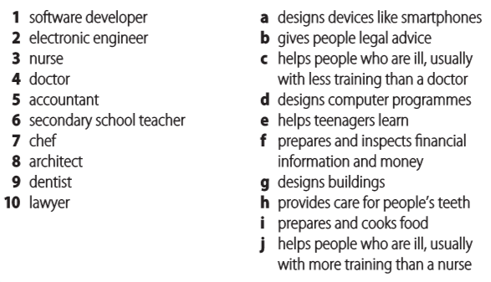
Match the jobs (1–10) with the correct description (a–j).
d
a
c
j
f
e
i
g
h
b

Slide 4
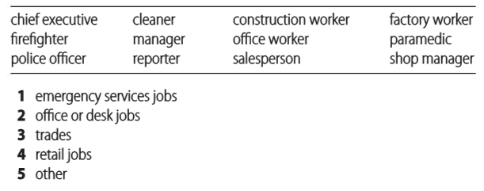
JOBS
Look at these jobs. Which category does each one belong to? Think of one more job for each category. Use a dictionary if necessary.
2
3
3
3,5
1
2,4
2
1
1
5
4
4
A job, especially one that needs special skill, that involves working with your hands:
She went to college to learn a trade.

Slide 5

Listening
Listen to Tomas and Julia talking about photographer Anand Varma. What's important to Julia in a job? What's important to Tomas?
Julia
fun
adventure
Tomas
staying near family
money
safety

Slide 6
Listening
Listen again. Are the sentences true or false, or is the information not given?
1. Julia would like to travel for work.
2. Tomas has travelled a lot.
3. Julia hasn't decided exactly what job she wants yet.
4. Tomas says if Julia wants to have a job like Anand Varma, she can do it.
5. Tomas would like to have a job like Anand Varma's.
6. Tomas says he'd like to be a doctor.
7. For Julia, it's important to have an interesting job.
8. Julia thinks Tomas should consider being a paramedic.
9. Julia wants to make a lot of money.
10. Tomas wants a job that's very exciting.
NG
NG
T
T
F
F
T
F
NG
F

Slide 7
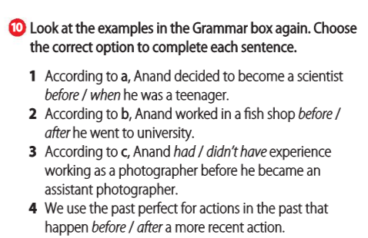
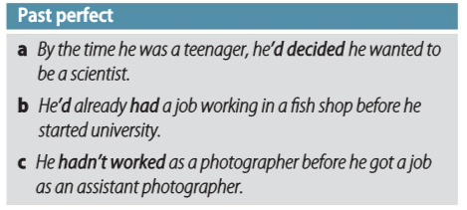
Past Perfect
We use by the time, meaning ‘when’, to connect an action that has happened before a second action.

Slide 8
Complete the article with the past simple or past perfect of the verbs in brackets.
An early love for the ocean Asha de Vos was born and grew up in Sri Lanka. As a baby, she loved the water and (1) (learn) to swim by the time she was three. And by the age of six, she (2) (decide) to become a marine biologist when she grew up. A job on a potato farm When she graduated from university in Scotland, Asha (3) (take) a job working on a potato farm. Although she had tried during her final year of university, she (4) (not be) able to find a job in marine biology, and now she (5) (need) money because she (6) (already decide) to travel to New Zealand to work on conservation projects – which she eventually (7) (do). Finding a career in marine biology After she (8) (work) for six months in New Zealand, she (9) (get) a job on a research boat and travelled the world's oceans, looking at whales. Eventually, she (10) (go) back to university and earned a PhD in marine biology. Now she's building a marine conservation research and education centre in Sri Lanka to share her love of the ocean with others.
had learned
had decided
took
had not been
needed
had already decided
did
had worked
got
went

Slide 9
Look at the article in Exercise 1. Write questions using the verbs in brackets. Use the past perfect or past simple.
1. When (you decide) to become a marine biologist?
2. (you try) to find a biology job before you finished university?
3. Why (you take) a job on a potato farm?
4. How long (you be) in New Zealand before you got the research job?
5. What did you do after (you get) your PhD?
did you decide
Had you tried
did you take
had you been
you got

Slide 10
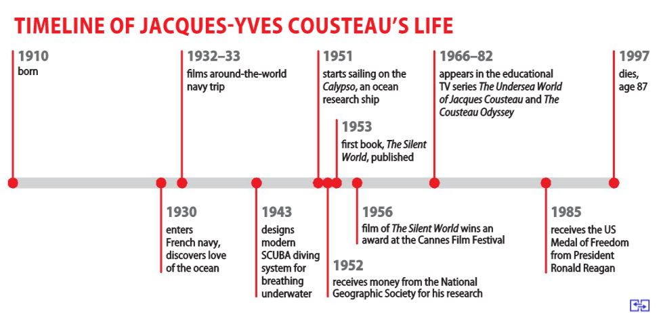
Look at the timeline of Jacques-Yves Cousteau's life. Then use the words and time expressions to make sentences with the past simple and past perfect.
1. be 21 / discover love of the ocean (by the time)
By the time he was 21, Cousteau had discovered his love of the ocean.
2. Cousteau be in the navy for two years / travel around the world (when)
3. Cousteau give 20 years of his life to the ocean / receive money from the National Geographic Society for his work (when)
Cousteau had been in the navy for two years when he travelled around the world.
Cousteau had given 20 years of his life to the ocean when he received money from the National Geographic Society for his work.

Slide 11
Look at the timeline of Jacques-Yves Cousteau's life. Then use the words and time expressions to make sentences with the past simple and past perfect.
4. Cousteau write the book / The Silent World / make the film (before)
5. Cousteau be a TV star / for more than 15 years / he receive the Medal of Freedom (before)
6. he die / share his love of the ocean / with millions of people around the world (by the time)
Cousteau had already written the book The Silent World before he made the film.
Cousteau had been a TV star for more than 15 years before he received the Medal of Freedom.
By the time he died, Cousteau had shared his love of the ocean with millions of people around the world.

